Slide 1
JKR Finance
2020-10-01

Slide 2
Balanced Portfolio Summary
The sortino ratio for the last 12 days is -0.0708888.

Slide 3
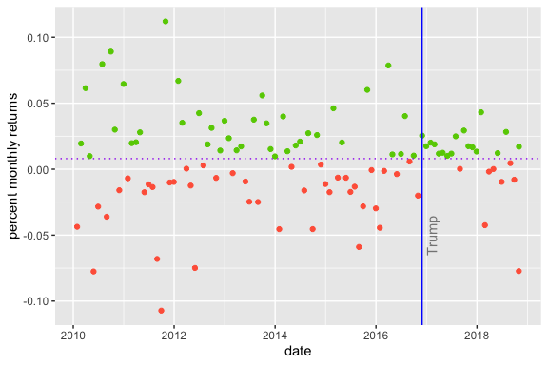
Returns
Colored by default return rate

Slide 4
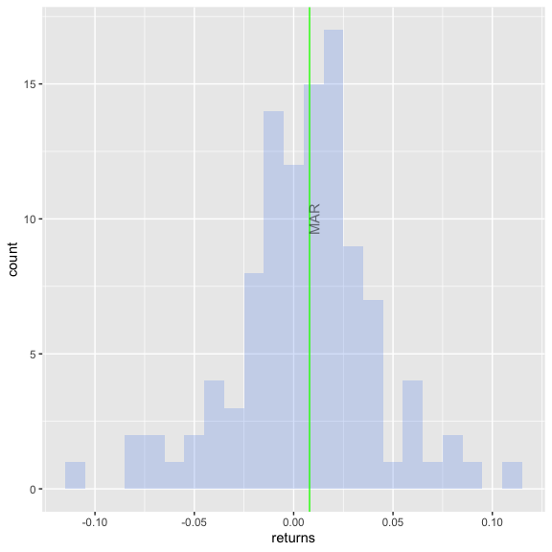
Portfolio Downside

